Slide 1

Department of Information Technology
NBA Accredited A.P. Shah Institute of Technology G.B.Road,Kasarvadavli, Thane(W), Mumbai-400615 UNIVERSITY OF MUMBAI Academic Year 2020-2021

Slide 2
A Project Report on IoT based Healthcare kit with Chatbot Submitted in partial fulfilment of the degree of Bachelor of Engineering(Sem-8)
in INFORMATION TECHNOLOGY By Akshata Singh(17104033)
Purvika Gaikar(15104027) Shreya Bhutada(17104019) Under the Guidance of Prof. Kaushiki Upadhyaya
Prof. Vishal Badgujar

Slide 3
1.Project Conception and Initiation

Slide 4
1.1 Abstract
The Healthcare of a country plays a major role in defining a country’s development.
It is the expenditure, quality, and accessibility of health services that govern the quality of healthcare.
A significant issue in rural India is the 1:10,000 ratio of doctor to patient, which is now resolved by this kit because doctors all over India can now access the data on their timeline.
With this in mind, we aim to develop an IoT based healthcare kit with chatbot that provide primary patient monitoring and care assistance to strengthen our country’s healthcare system from rural to urban sectors.
A web-based application is also provided which is integrated with Chatbot for our system to broaden usability.

Slide 5
1.2 Objectives
Develop an absolute, portable and cheap system that will be 24/7 available.
Lessening the communication gap by providing quick access to doctors via web-based portal.
Aid the disabled and old people who cannot come to hospitals independently for their regular checkups.
Enable constant monitoring of a patient by providing real time analysis of health parameters.
Storing the Electronic Health Record and sensor’s data on Cloud to ease accessibility.
Ease the usability by developing a Web based application.
Integration of chat bot that would assist medical queries, symptom check and provide referral for major health issues that would decrease time and expenditure of patients.

Slide 6
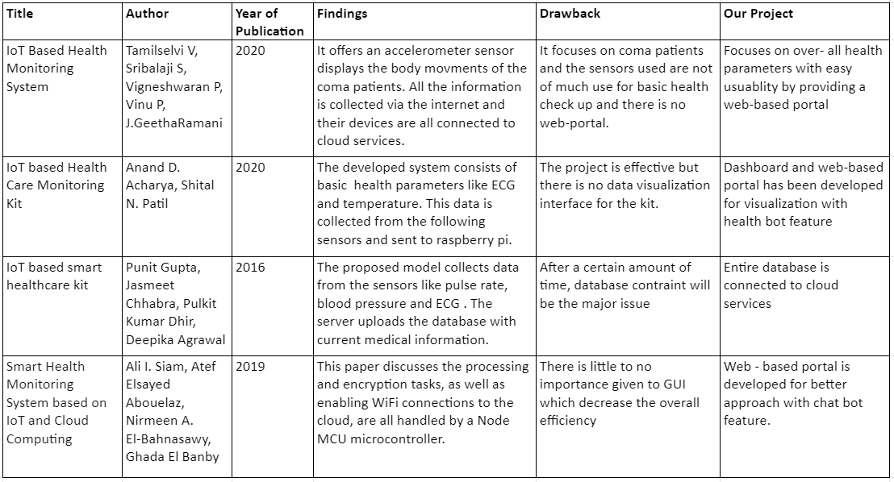
1.3 Literature Review

Slide 7
1.4 Problem Definition
Many rural areas don’t have enough physicians, hospitals and other health care resources to provide quality care for the whole population.
Long waiting times, long duration between visits and a wide range of other challenges can prevent health care professional from providing the best care possible.
The websites available are mostly comprised of a particular hospital which reduces the versatility and also doctors don’t have enough time to give to online as well as incoming patients.
In addition to this, there are applications which are just limited to making appointments with doctors and very minimal interaction related to disease condition of the patients.
This project aims at providing an IoT based remote Health care kit and AI Chatbot which provides healthcare tips to patients, and effectively, reducing the cost of customer service and providing a vital communication link between doctors and patients.

Slide 8
1.5 Scope
A valuable asset to Healthcare sector
Remote Patient Monitoring
Reduced Healthcare cost
Care for elderly
Health Chatbot facility
Quick access to doctors
Reduce the pollution by making everything digitally available

Slide 9
1.6 Technology stack
Hardware Components:
Arduino UNO
Oximeter MAX 30100
Temperature Sensor TMP 36
Pressure Sensor BMP 180
Capacitor
Resistor
Touch Display – Nextion 2.4”
Software’s Used:
HTML5
CSS
Bootstrap
JQuery
MySQL
Xampp
Node-Red
AWS
Nextion
Tinkercad

Slide 10
1.7 Benefits for environment & Society
Useful in the healthcare sector, mainly in rural areas, where there are limited facilities of resources and hospitals.
Extremely efficient for disabled and old-age people who cannot independently come for regular checkups
With such feasibility of web portal and chatbot, it will help decrease time and expenditure of patients.
Casing used for the development of a healthcare kit will be made from a biodegradable material.
As this kit doesn’t require any paperwork, we will be saving a lot of wood and electricity consumption. No waste will be generated. Therefore, it is not going to contribute to any sort of land pollution.

Slide 11
2. Project Design

Slide 12
2.1 Proposed System
IoT based Health care kit consisting of:
Blood pressure sensor BMP 180
Temperature sensor TMP 36
Pulse Oximeter MAX30100
Kit is connected to Node-Red for database management.
Website based application for better understanding of data and easy usability.
Integration of Chatbot in the application programmed with Rasa.

Slide 13
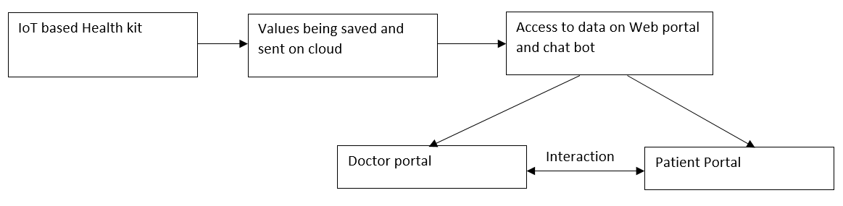
2.2 Design(Flow Of Modules)

Slide 14
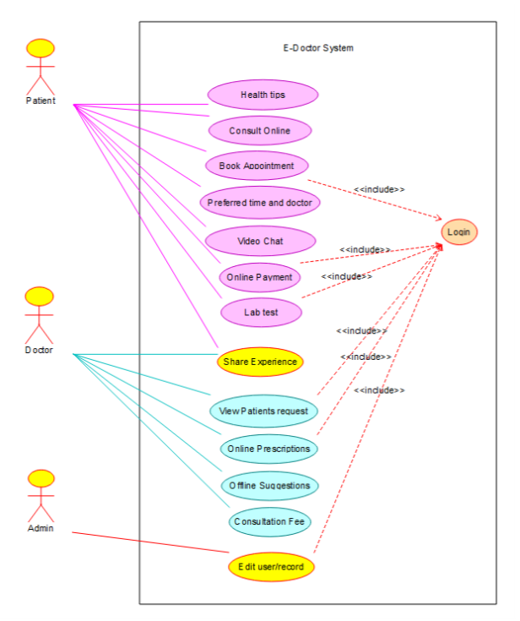
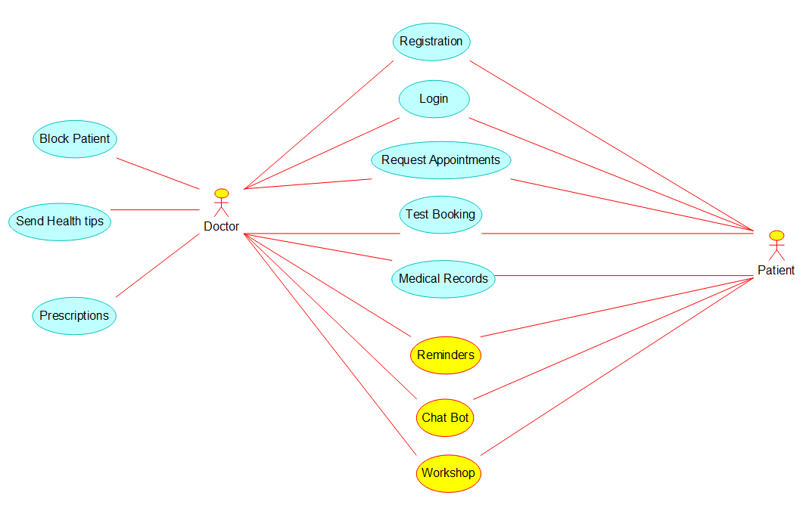
2.3 Description Of Use Case

Slide 15
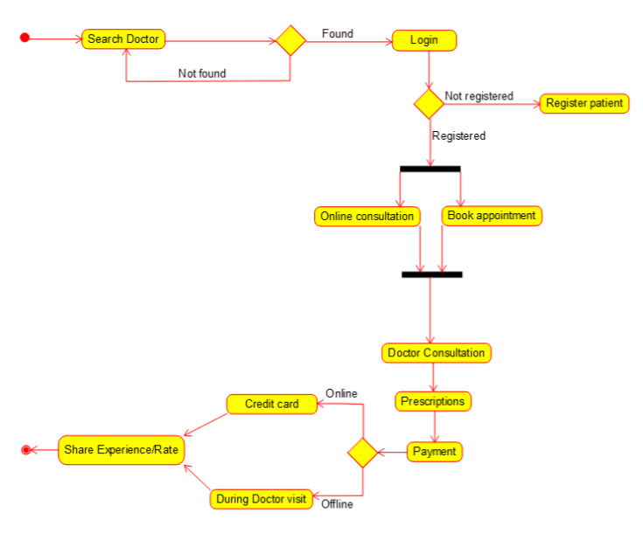
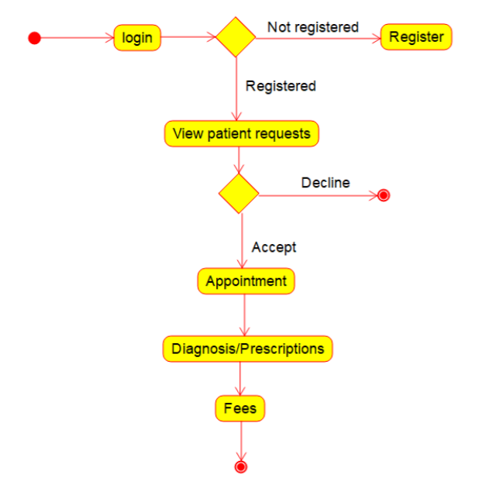
2.4 Activity diagram
Activity diagram of a patient consulting a doctor in our system
Activity diagram of doctor viewing the request in our system

Slide 16
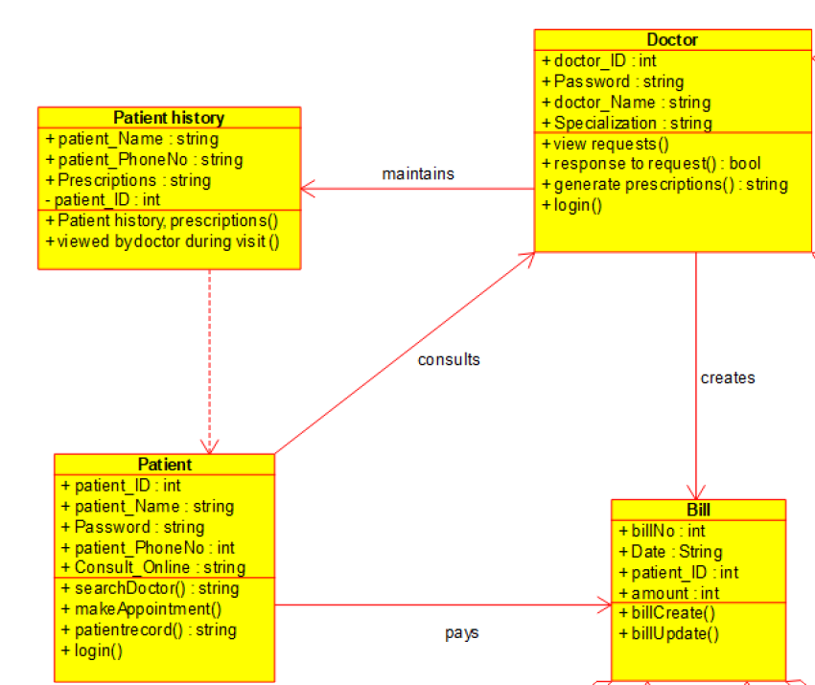
2.5 Class Diagram

Slide 17
3. Implementation

Slide 18
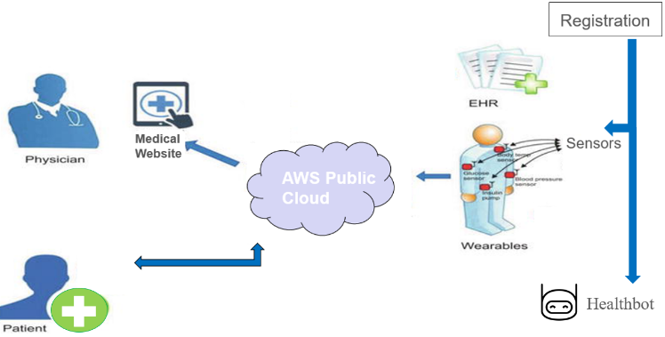
3.1 Implementation

Slide 19
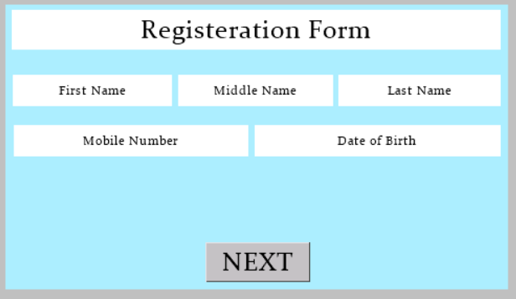
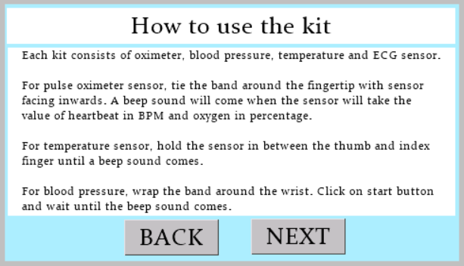
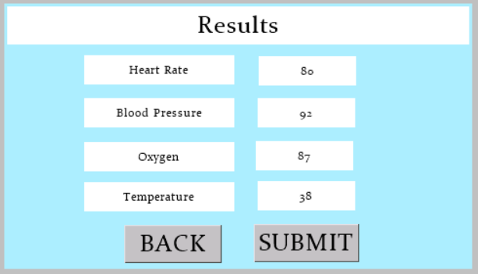
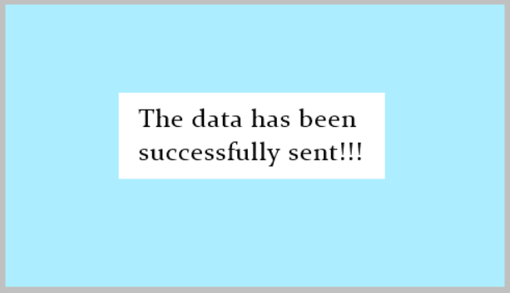
3.2 Implementation – Health kit GUI

Slide 20
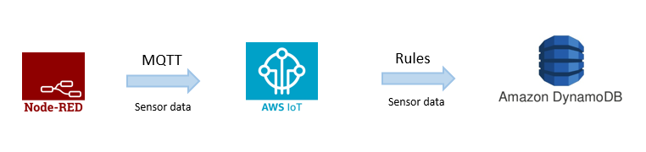
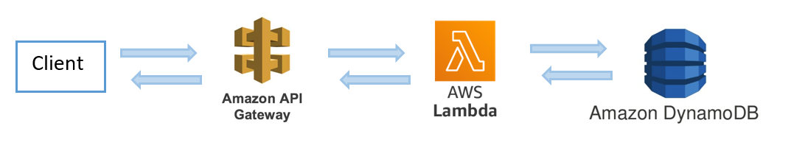
3.4 Implementation – Sensor to Cloud flow diagram
Fig. Flow diagram of storing sensor data
Fig. Flow diagram of retrieving sensor data

Slide 21
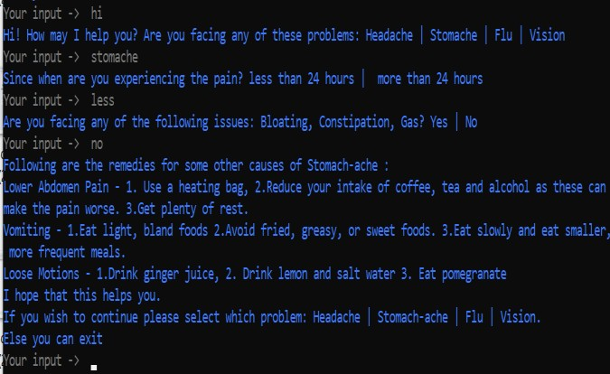
3.5 Implementation – Rasa Chatbot on Terminal

Slide 22
4. Testing

Slide 23
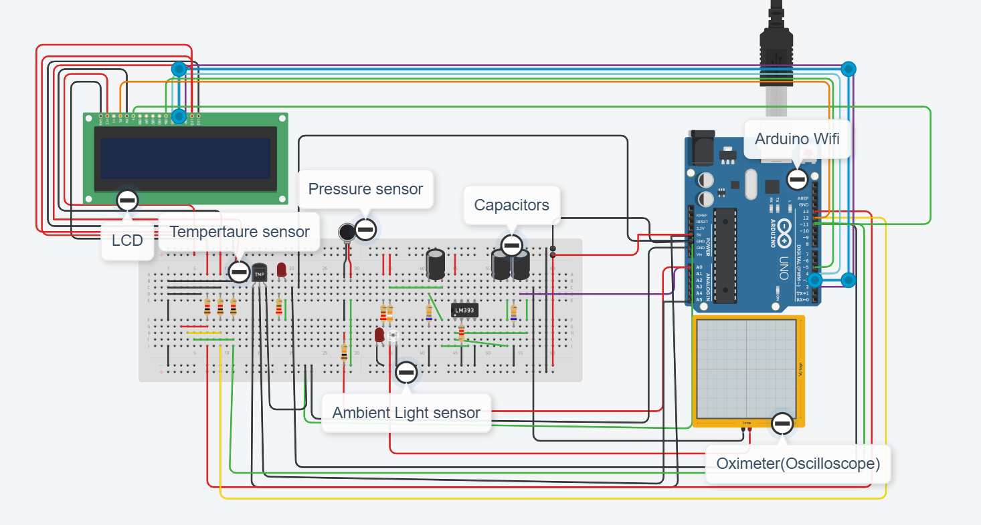
4.1 Testing – Circuit Diagram

Slide 24
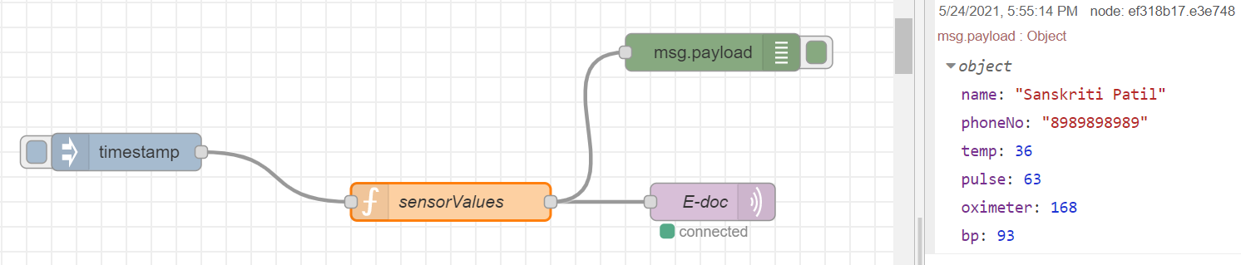
4.1 Testing – Node Red

Slide 25
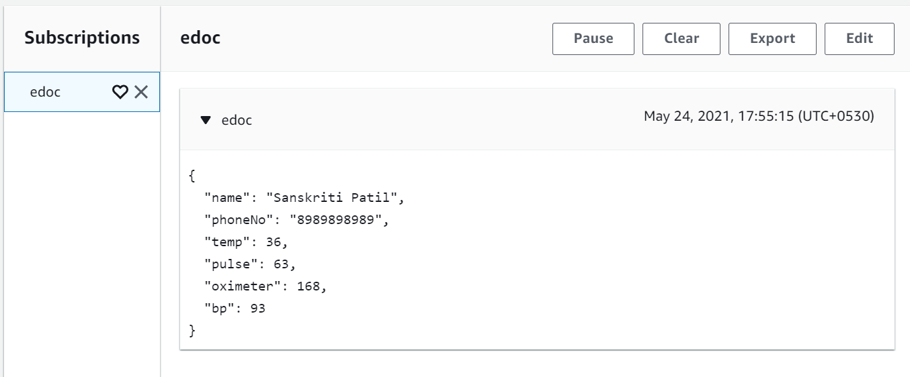
4.2 Testing

Slide 26
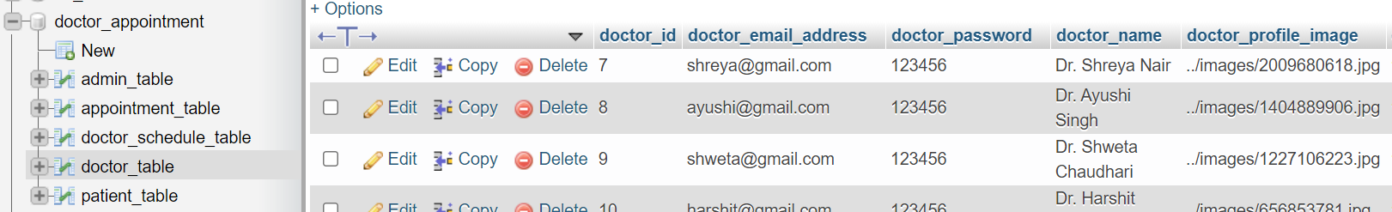
4.4 Testing – Database Management

Slide 27
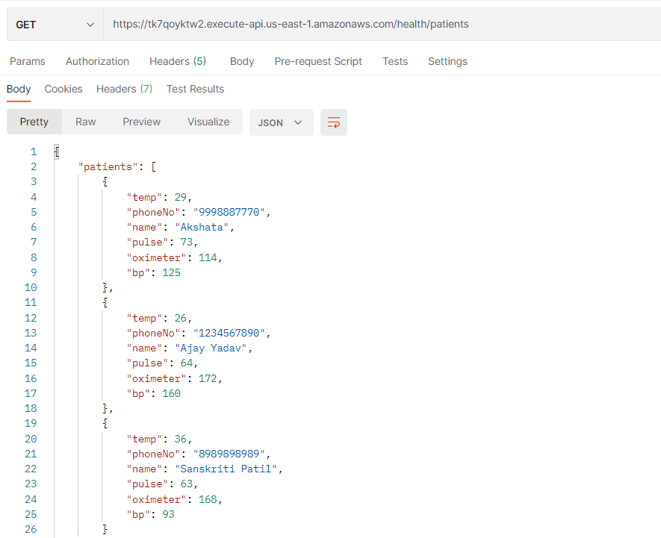
4.5 Testing – API testing

Slide 28
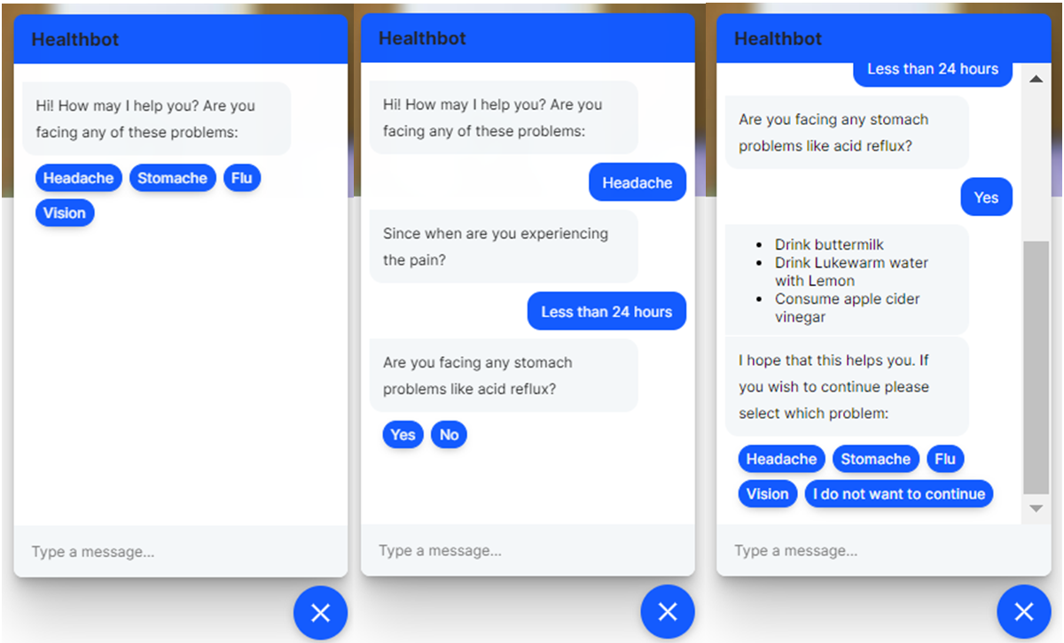
4.6 Testing– Health Bot

Slide 29
5. Result

Slide 30
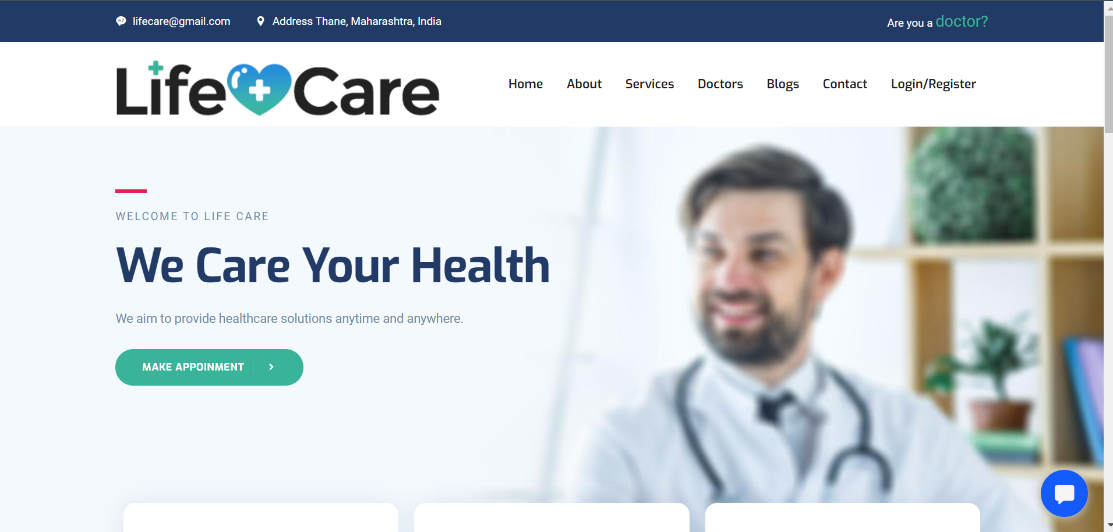
5.1 Results – Web-based portal

Slide 31
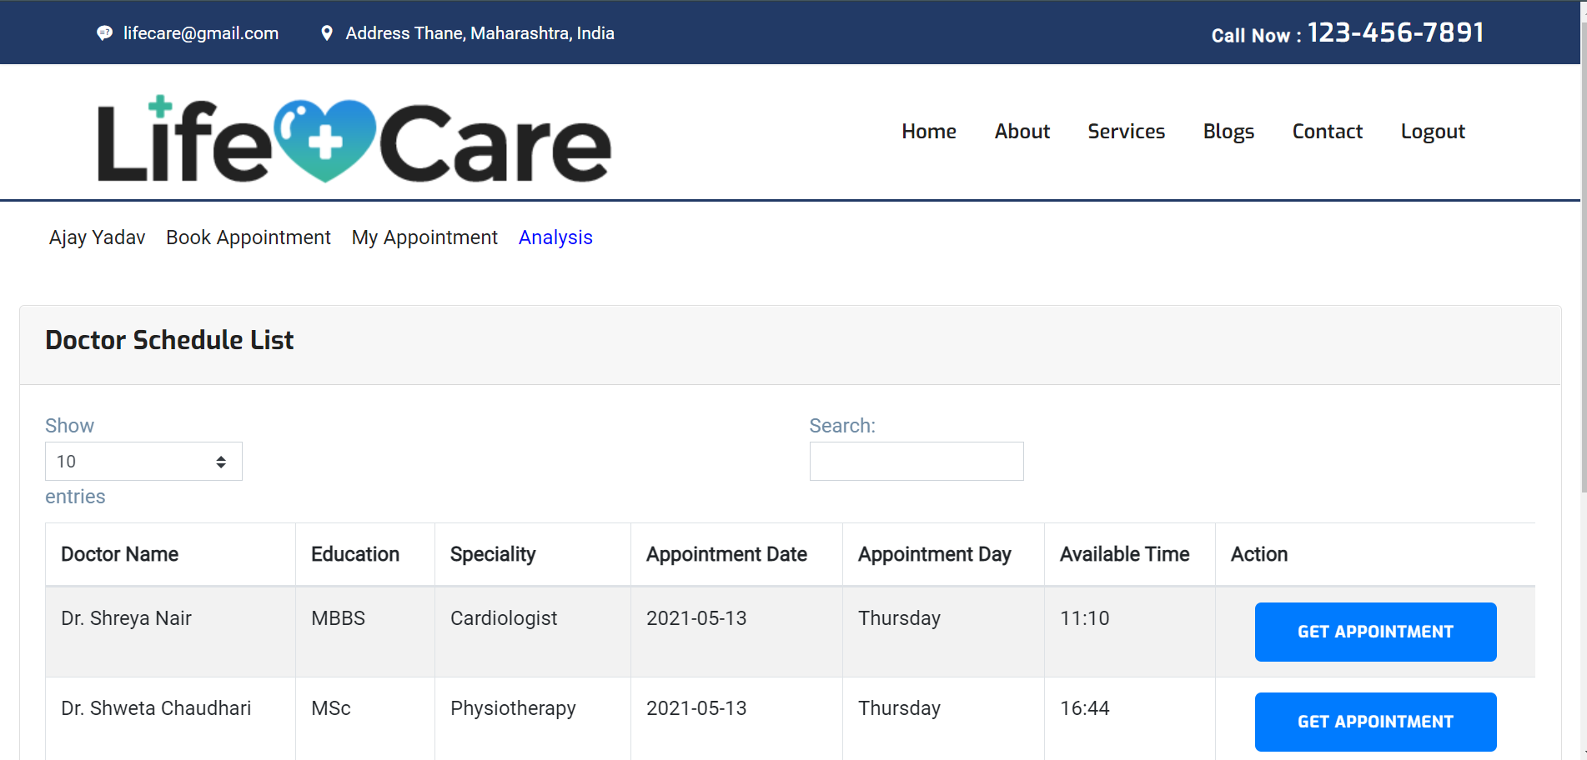
5.2 Results – Patient Side

Slide 32
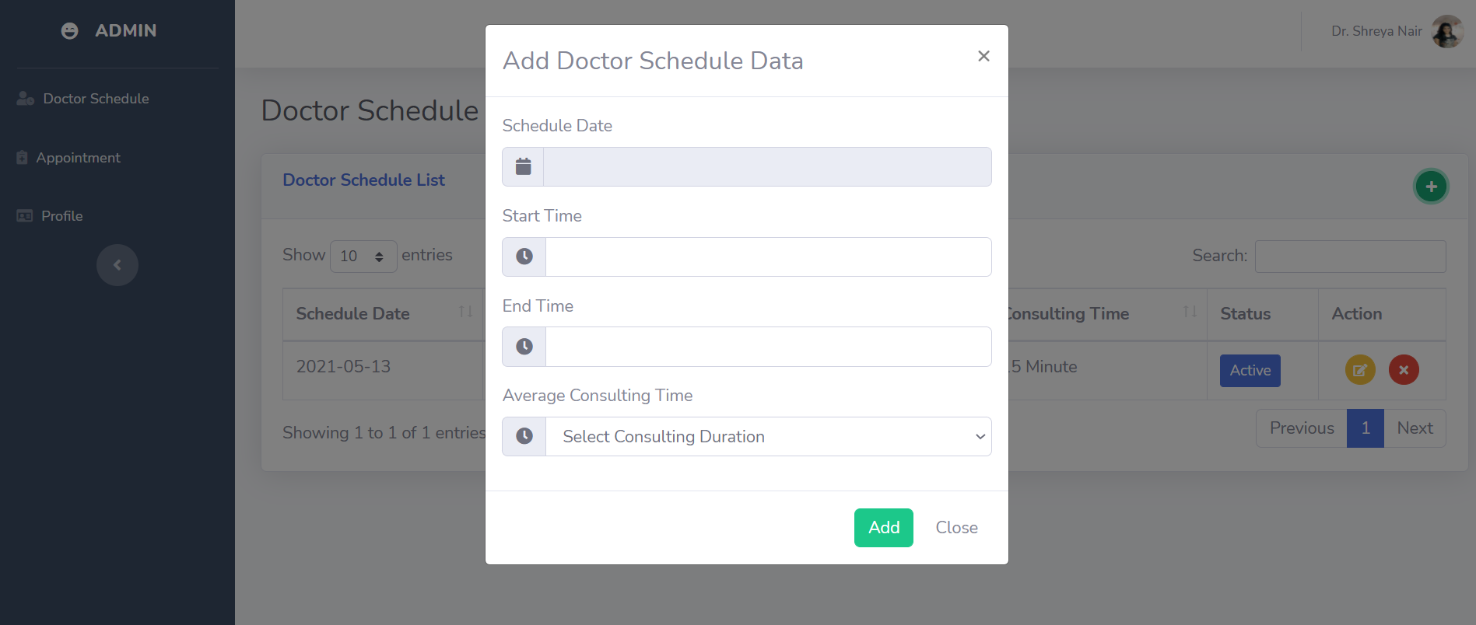
5.3 Results – Doctor adding schedule

Slide 33
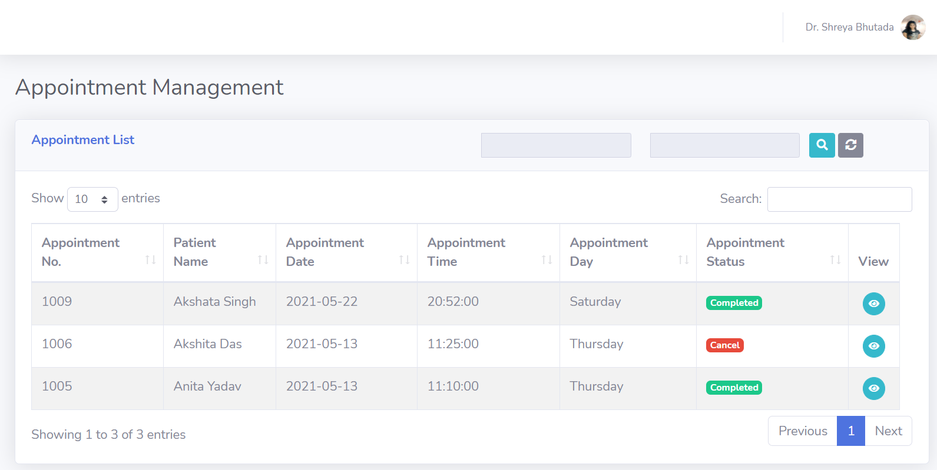
5.4 Results – Appointments scheduled for Doctor

Slide 34
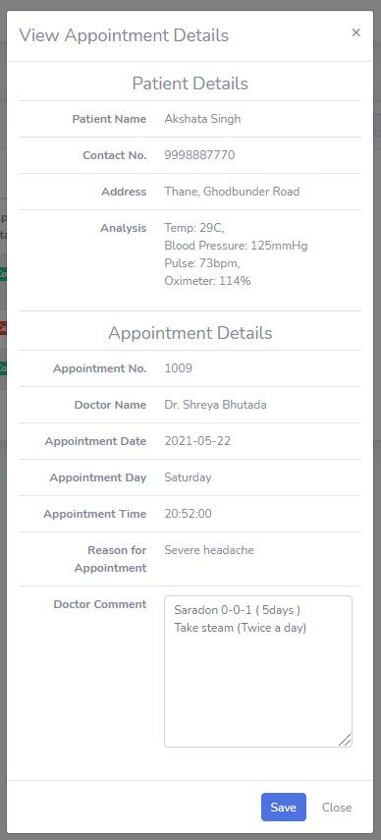
5.5 Results – Health Parameters

Slide 35
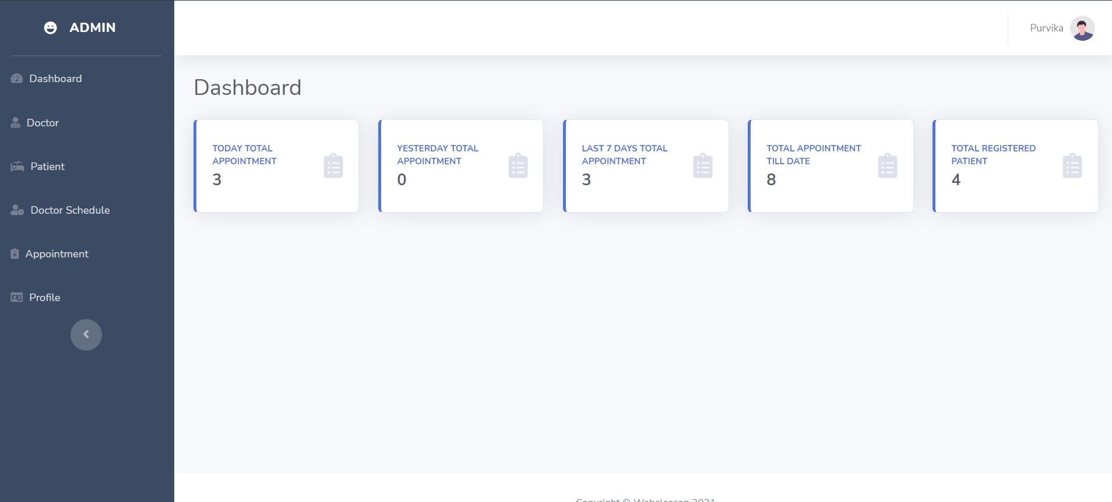
5.6 Results – Admin Dashboard

Slide 36
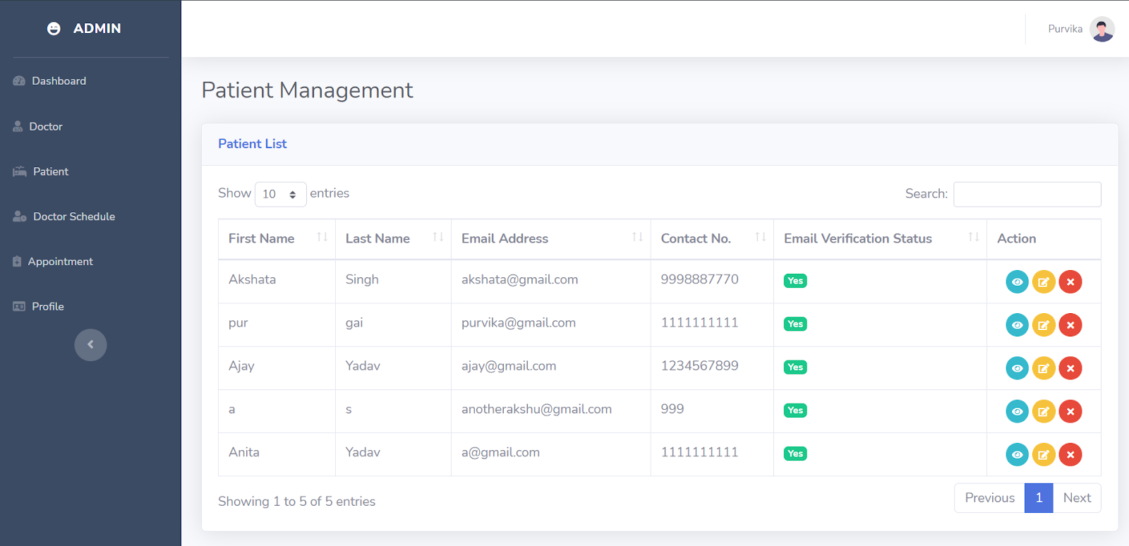
5.7 Results – Patient Management

Slide 37
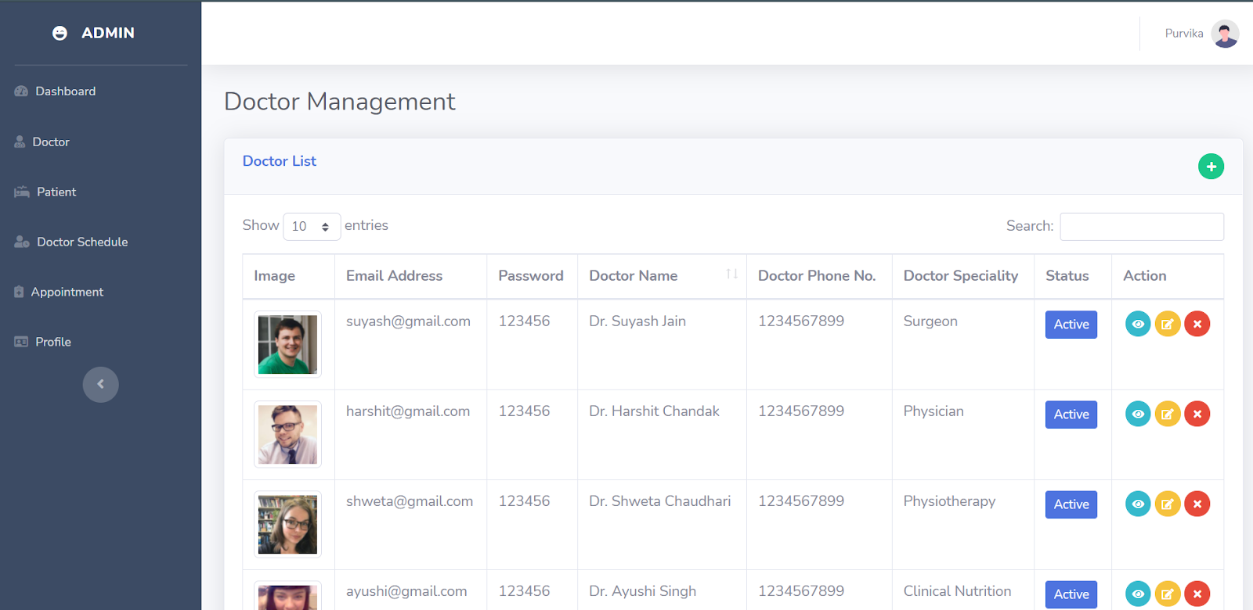
5.8 Results – Doctor Management

Slide 38
6. Conclusion and Future Scope

Slide 39
6.1 Conclusion
The proposed system provides healthcare solutions anytime and anywhere.
It will majorly benefit people living in the rural areas as well as the elderly and disabled people.
Internet based Things system obtains real-time medical information about a patient and stores it in the cloud as Electronic Health Record which helps in data management.
The health bot helps in better understanding of the medical terminologies and provides a customized service to the patients via text analysis.
Our web application along with health bot can contribute to ease of accessibility to the masses as it can be used by rural people through mobile phones.
We aim to make virtual assistance to doctors, patients, and workers to build better and well-connected healthcare for society.

Slide 40
6.2 Future Scope
The project is not connected to any pharmaceutical company as of now. The survey made will be used to analyze what type of illness is majorly caused in every region and according to that the supply of medicines to the respective regions can be added. Consequently, it wouldn’t lead to shortage of medicines.
In addition to that, an additional feature will be added on the doctors portal which can directly send the prescription of patients to the pharmacy and the delivery can be made.
An enhanced version of a health bot will be developed to solve complicated issues and provide more options for consultation.
We will add advanced machine learning to increase the efficiency of the health bot.

Slide 41
References
Tamilselvi V, Sribalaji S, Vigneshwaran P, Vinu P, GeethaRamani J. IoT based health monitoring system. In: 2020 6th International conference on advanced computing and communication systems (ICACCS). IEEE; 2020. p. 386–9
A. D. Acharya and S. N. Patil, "IoT based Health Care Monitoring Kit," 2020 Fourth International Conference on Computing Methodologies and Communication (ICCMC), Erode, India, 2020, pp. 363-368, doi: 10.1109/ICCMC48092.2020.ICCMC-00068
Katariya, Vivek & Vitthal, Shinde & Gutte, & Devare, Manoj. (2019). Intelligent Healthbot for Transforming Healthcare.
https://aws.amazon.com/iot-core/features/
Hossain, Md Anowar & Qureshi, Md. (2020). IoT Based Medical Assistant Robot (Docto-Bot).

Slide 42
Paper Publication
Paper entitled “Ru-Urb IoT-AI powered Healthcare Kit” is presented and published at “5th International Conference on Intelligent Computing and Control Systems ICICCS 2021” by “Shreya Bhutada”, “Akshata Singh”, “Purvika Gaikar ”and “Kaushiki Upadhyaya”.

Slide 43
Thank You

